Slide 1
STUDENT DETAILS
Name : Kedam Jayasimha
Email-ID : kedamjayasimha791@gmail.com
College Name : SV College of Engineering(Tirupati)
Internship Domain : Frontend Development
Start and End date of Internship : 06/06/2023 to 21/06/2023

Slide 2

PROJECT TOPIC:
Portfolio Website
A portfolio website is a unique way to showcase your work and let others know about yourself.
It is a professional website that provides information about what you do, what services you may offer, and how to contact you or your company
A student portfolio is a visual resume that allows you to
showcase your best work and present yourself to
potential employers
I have created a portfolio website that showcase all
my skills, projects, qualifications etc.,

Slide 3

AGENDA:
ABOUT PROJECT
The project is about developing a portfolio website that lets you show off all of your work in one place
TECHNOLOGIES USED
Welcome to my portfolio website that I have developed using:
HTML
CSS
Bootstrap
JavaScript
RESPONSIVENESS AND DYNAMIC
It is a well designed responsive website that adopts the to the screen size and acts accordingly based on the screen size
Also it is a Dynamic website as I have used JavaScript which is responsible for creating dynamic websites

Slide 4

PROJECT OVERVIEW:
Student portfolios are collections of student work that can demonstrate learning or be used as an effective assessment tool
A student portfolio is a compilation of academic work and other forms of
educational evidence assembled for the purpose of:
evaluating coursework quality, learning progress, and academic achievement
(2) determining whether students have met learning standards or other
academic requirements for courses, grade-level promotion, and graduation
(3) helping students reflect on their academic goals and progress as learners

Slide 5

WHO ARE THE END USERS OF THIS PROJECT?
End users for a portfolio site include potential clients seeking services, employers looking to hire, recruiters scouting for talent, industry peers seeking inspiration.
Potential Clients: Individuals or companies looking to hire or collaborate with professionals in a specific field
Employers: Companies or organizations seeking to hire new talent. Recruiters: Professionals responsible for sourcing and evaluating candidates for job openings.
Industry Peers: Professionals within the same industry or field who are interested in staying updated with the work and accomplishments of their peers

Slide 6
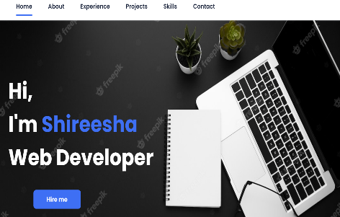
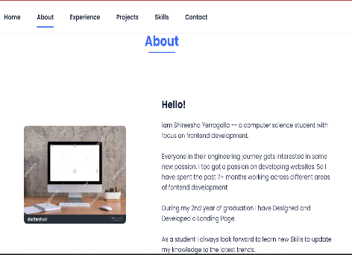
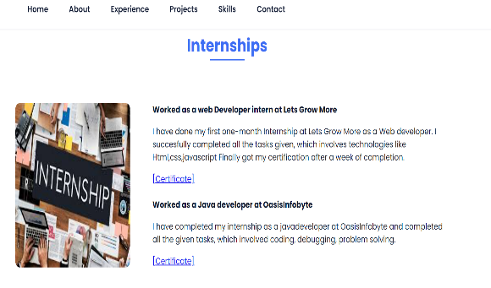
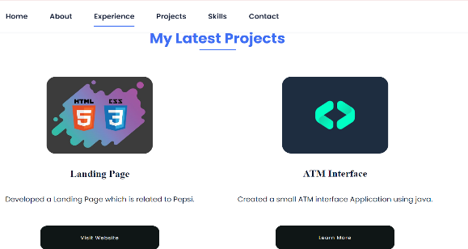
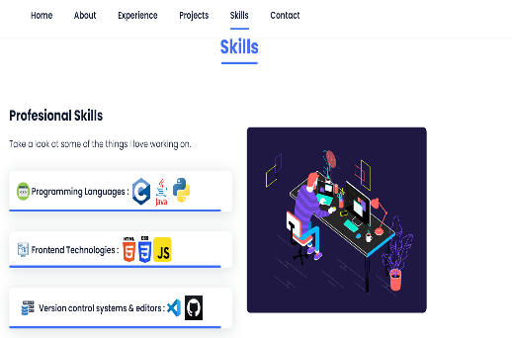
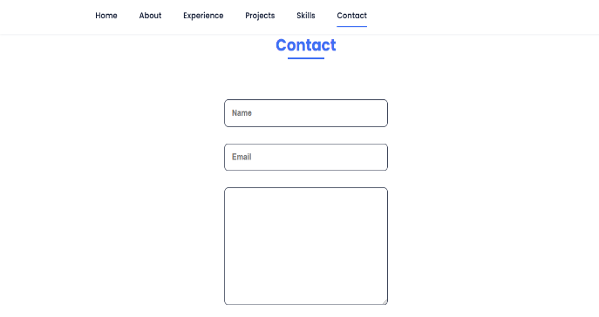
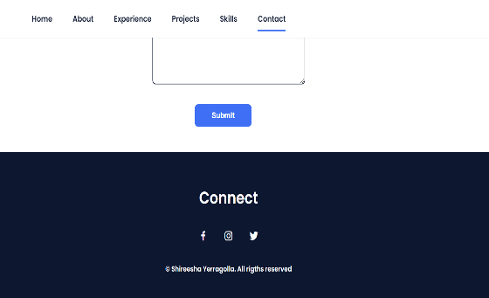
SOLUTION AND PRESENTATION:
The main purpose of portfolio is to exemplifies your beliefs, skills, qualifications, education, training, and experiences. It provides insight into your personality and work ethic.
The high-level benefit of project portfolio management is creating a reliable system within which companies can consistently manage their projects and programs.
Presenting my portfolio images:

Slide 7

INNOVATIVE AND CREATIVE FEATURES:
Responsive
Dynamic
Customized content and Descriptions
Unique visual identity
3D effects
Engaging user Experience

Slide 8
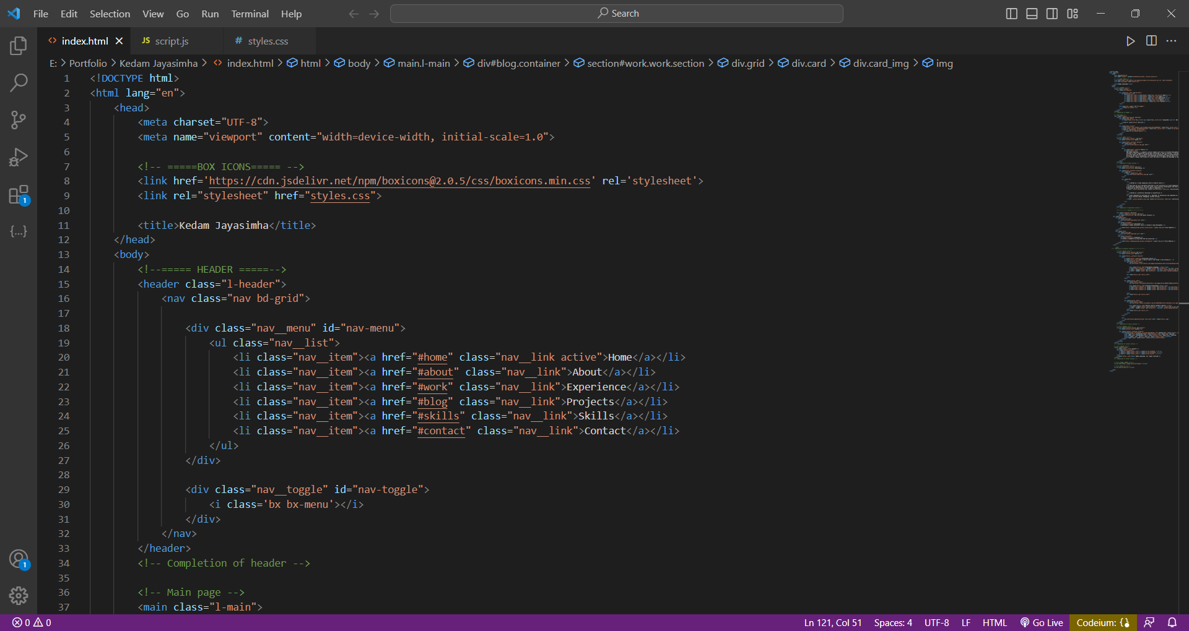
MODELLING:
Modelling with HTML

Slide 9
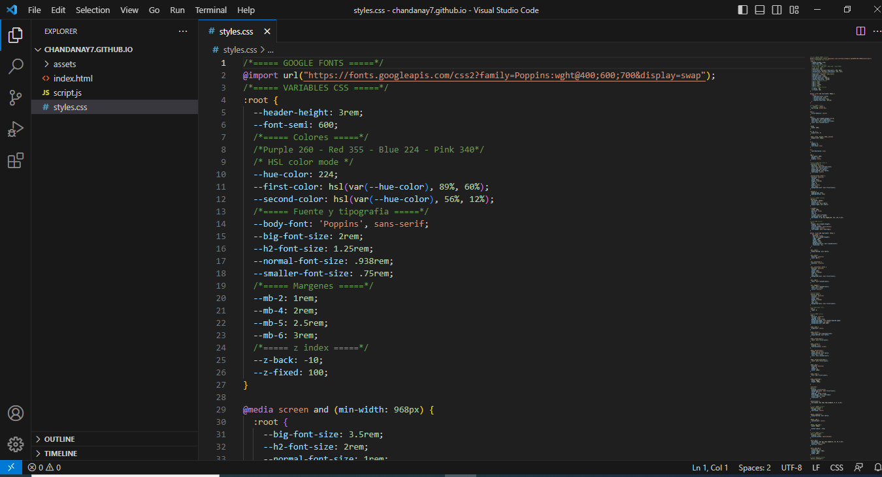
Modelling with CSS

Slide 10
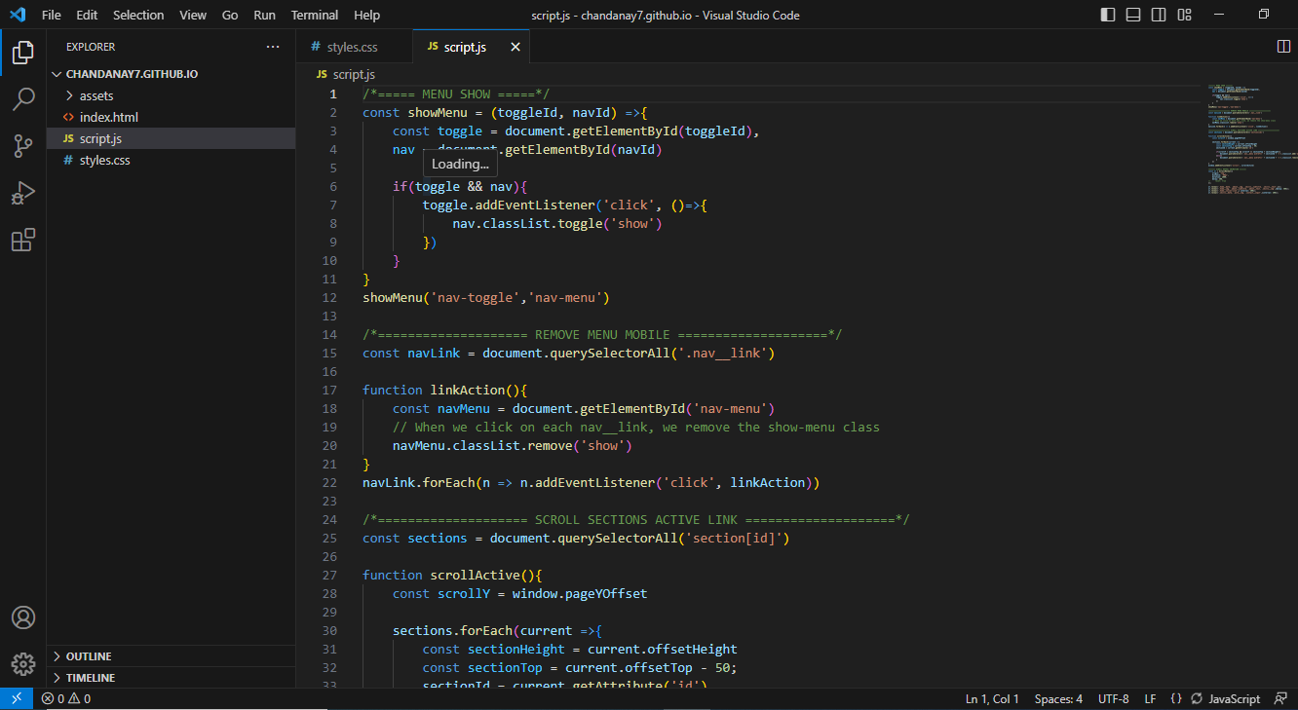
Modelling with JavaScript

Slide 11
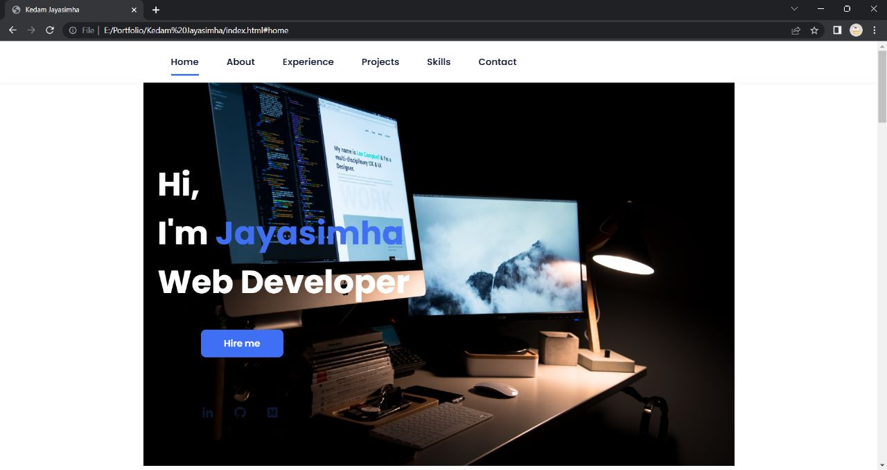
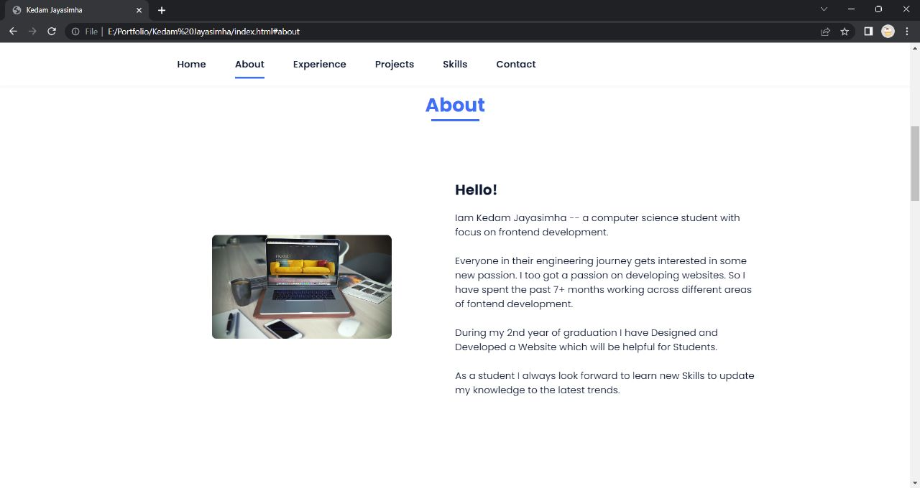
Output:

Slide 12
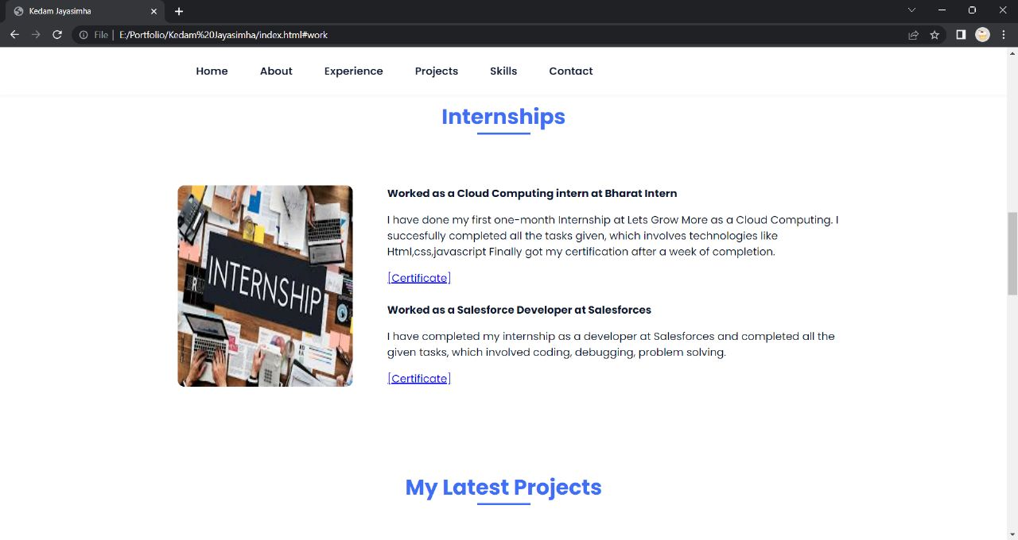
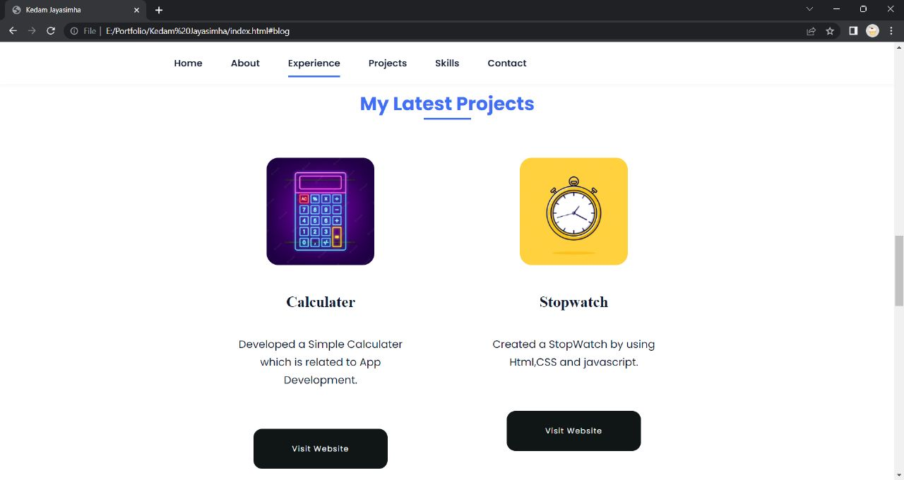

Slide 13
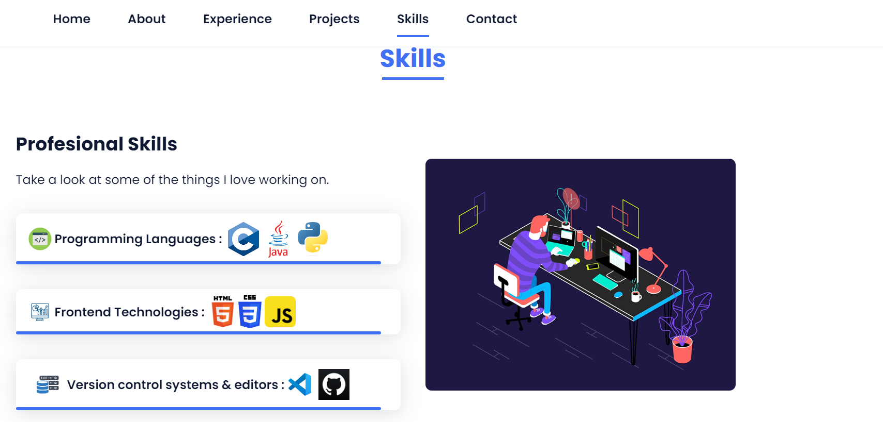


Slide 14
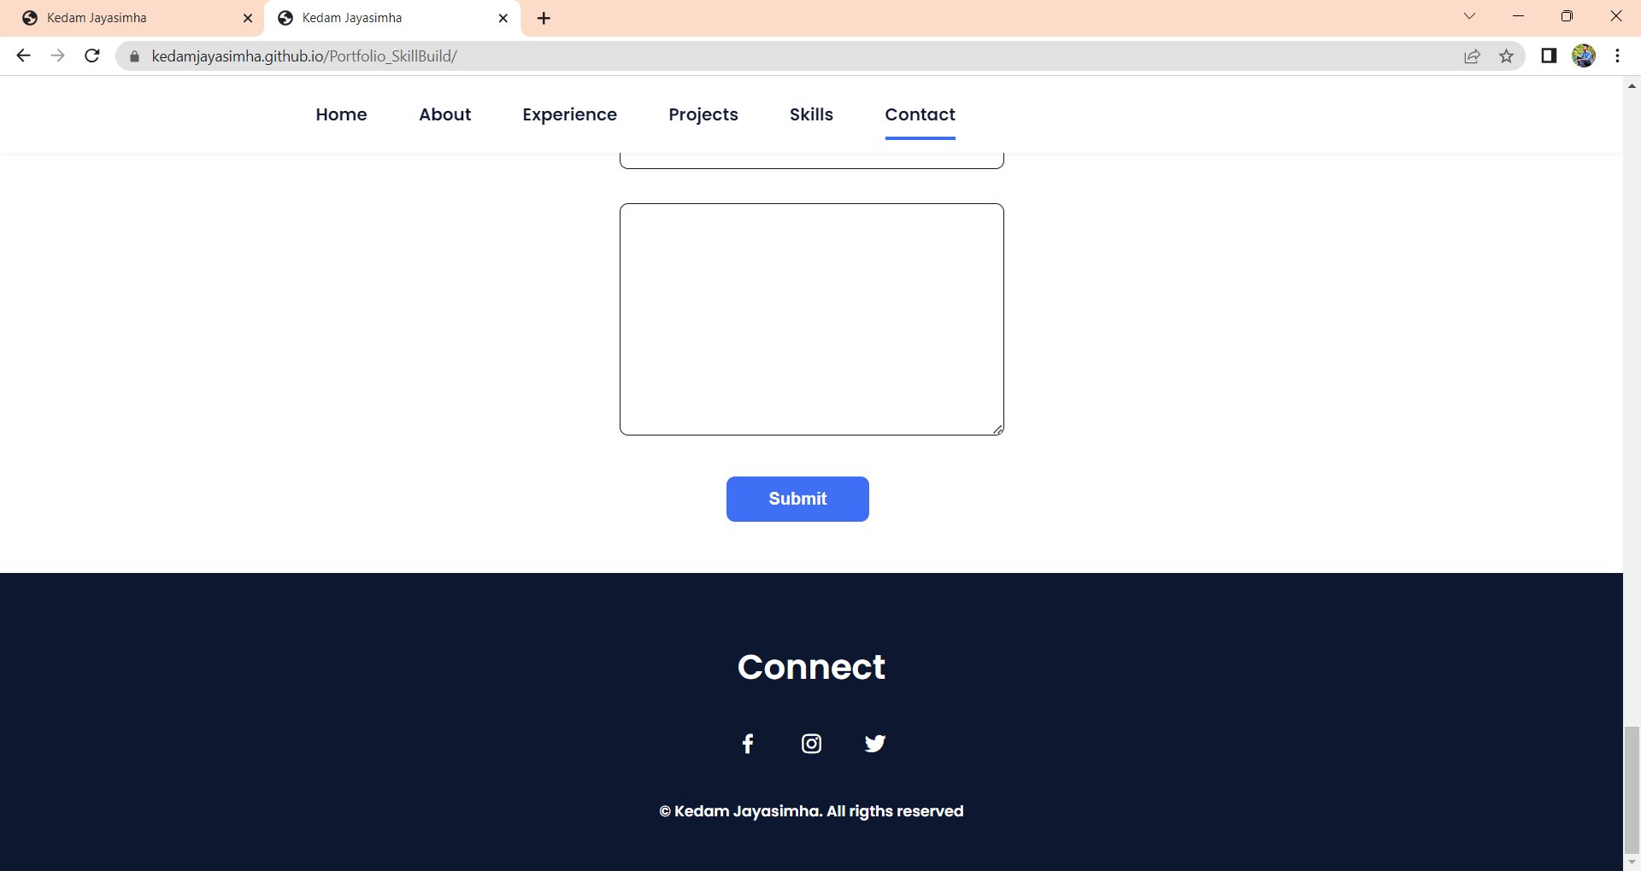

Slide 15

RESULTS:
Improved User Experience: The intuitive navigation and engaging interface of the portfolio site resulted in a seamless and enjoyable user experience.
Expanded Reach and Opportunities: The portfolio site significantly increased the portfolio owner's reach, attracting a broader audience and opening doors to new opportunities

Slide 16

LINKS:
View Code(Github link):
https://github.com/KedamJayasimha/Portfolio_SkillBuild
Visit Website:
https://kedamjayasimha.github.io/Portfolio_SkillBuild/

Slide 17

THANK YOU

